Slide 1
ATME COLLEGE OF ENGINEERING
DEPARTMENT OF COMPUTER SCIENCE & ENGINEERING
Project On
“Named Entity Recognition in social media using Machine Learning”
Subject: PROJECT
Subject Code: 21CSP76
Under the Guidance of
Mrs. Sushma V
Assistant Professor
Dept. of CSE, ATMECE
Submitted By
AISHWARYA M S (4AD21CS004)
ESHWAR A M (4AD21CS021)
KUSHAL R (4AD21CS039)
LAKSHMIPRIYA H P (4AD21CS040)

Slide 2
CONTENTS
Abstract
Introduction
Problem Statement
Objectives
Literature Review
Existing System
Proposed System with Methodology
Implementation
Snapshots
Hardware Requirements & Software Requirements
Conclusion
References

Slide 3
Abstract
Named Entity Recognition (NER) is a key NLP task for identifying and classifying entities in text.
This project utilizes a fine-tuned BERT model on social media data, addressing challenges like noise and informal language.
We evaluate the performance of our model on benchmark datasets and analyze its effectiveness in handling diverse linguistic challenges
The results demonstrate that our proposed system achieves competitive performance, providing a robust solution for real-world applications such as information retrieval and decision support systems.

Slide 4
Introduction
This project leverages BERT's bidirectional architecture to improve the accuracy of NER on social media text.
The goal is to transform noisy, unstructured data into actionable insights for applications like sentiment analysis and trend detection.
Recent advancements in machine learning, particularly transformer-based architectures like BERT and GPT, have significantly improved the performance of NER systems by leveraging contextual embeddings and transfer learning.
This project aims to design, implement, and evaluate an NER system using state-of-the-art machine learning techniques. We explore preprocessing methods, model architectures, and evaluation metrics to create a robust system that can generalize well to real-world datasets.

Slide 5
Problem Statement & Objectives
Problem Statement
Extracting meaningful information from unstructured social media text is a significant challenge due to its informal language and lack of grammatical consistency.
Objectives
Detect and classify named entities.
Identify entities like Person, Location, and Organization.
Optimize the model for high accuracy in social media environments.

Slide 6
Literature Review
Year | Author(s) | Title | Purpose | Algorithms/Models | Key Objectives
2024 | Davlatyor Mengliev, Vladimir Barakhnin, Nilufar Abdurakhmonova, Mukhriddin Eshkulov | Developing Named Entity Recognition Algorithms for Uzbek: Dataset Insights and Implementation | To create a dataset and develop NER algorithms tailored for the Uzbek language, a low-resource language. | Dictionary-based algorithm, Neural network model (SpaCy framework) | Explore the performance of dictionary-based and neural network approaches for NER tasks in Uzbek.
2024 | Saja Murtadha Hashim and Kürşat Mustafa Karaoğlan | Advances in Named Entity Recognition: Exploring State-Of-The-Art Methods | Examines advancements in NER, focusing on its role in tasks like translation, summarization, and information retrieval. | BERT, BiLSTM-CRF, Transformer-based architectures | Highlights challenges like limited datasets, multilingual adaptability, and innovative methods like data augmentation and cross-lingual transfer learning.

Slide 7
Year | Author(s) | Title | Purpose | Algorithms/Models | Key Objectives
2024 | Adyasha Dash, Subhashree Darshana, Devendra Kumar Yadav, Vinti Gupta | A Clinical Named Entity Recognition Model Using Pretrained Word Embedding and Deep Neural Networks | Introduces a deep neural network-based clinical NER model utilizing pretrained embeddings for biomedical text. | Bi-LSTM, CRF, BERT, ELMO | Enhances entity detection in biomedical text, achieving an F1 score of up to 88.34%. Focuses on eliminating manual feature engineering.
2024 | David Nadeau and Satoshi Sekine | Multi-granularity Cross-Modal Representation for Emotion Recognition on Social Media | Explores multi-granularity cross-modal representation for emotion recognition, combining textual and visual data. | Advanced representation learning techniques | Improves emotion detection accuracy by integrating fine-grained and coarse-grained features.
2024 | Hongyu Chen, Li Dan, Yonghe Lu, Minghong Chen, and Jinxia Zhang | An improved data augmentation approach and its application in medical named entity recognition | Addresses challenges in Chinese medical NER, proposing data augmentation methods to enrich datasets. | BERT-BiLSTM-CRF, Word2Vec embeddings | Improves NER performance with a 1.49% F1 score boost through innovative augmentation methods.

Slide 8
Existing System
In the Existing systems they have used models such as CRF(conditional random fields) and HMM(hidden Markov models), struggle with informal social media text, resulting in low accuracy. They require frequent updates and have limited adaptability.
Disadvantages
Difficulty handling ambiguous entities and context-dependent words.
Poor scalability and adaptability to informal language.
Lower accuracy and recall rates for social media text.

Slide 9
Proposed System
This project proposes using a DistilBERT-based NER model fine-tuned on the CoNLLpp dataset. The system employs an aggregation strategy to merge subwords, improving the recognition accuracy of entities.
By using the transformer-based architecture of DistilBERT-based, the model is able to capture contextual nuances of words, even in short and informal social media posts. The proposed system also maps identified entities to user-friendly labels, making the extracted data more interpretable and actionable.
ADVANTAGES
High precision and recall for recognizing entities in noisy, informal text.
Scalable across multiple domains and adaptable to evolving language trends.
Efficient in processing large volumes of social media data with accurate results.

Slide 10
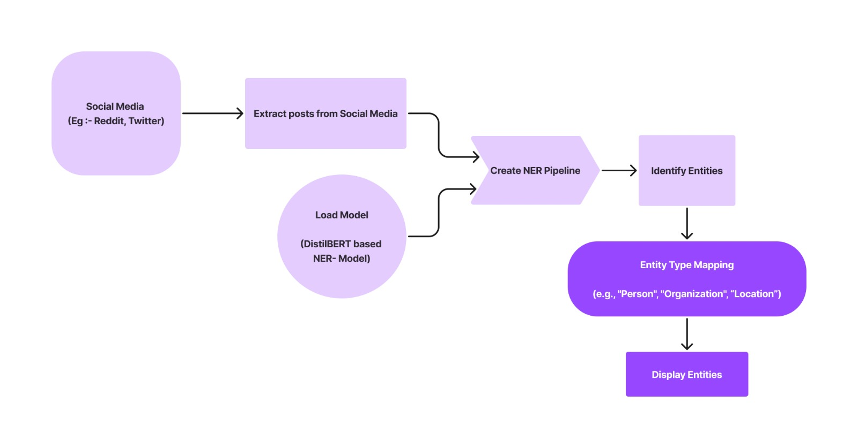
Methodology

Slide 11
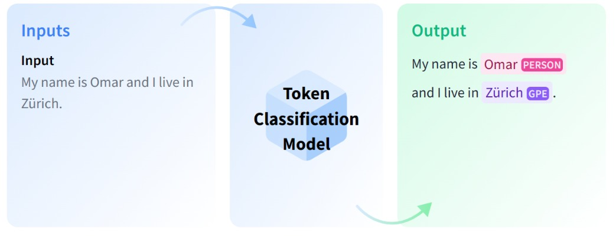
Methodology

Slide 12
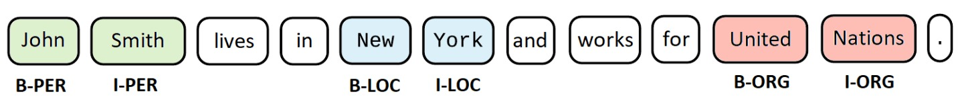
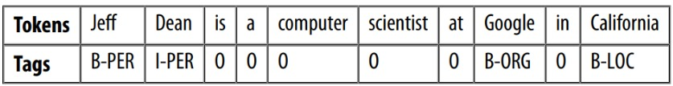
Implementation
"B" (Beginning): The first token of an entity is tagged with "B" to indicate the beginning of the entity.
"I" (Inside): Tokens subsequent to the first token of an entity are tagged with "I" to indicate they are inside the entity.
"O" (Outside): Tokens that are not part of any named entity are tagged with "O" to indicate they are outside any entity.

Slide 13
Implementation
To load NER model and txt to NER pipeline
token_classifier = pipeline(
"token-classification", model=checkpoint, aggregation_strategy = "simple"
)
Entities = token_classifier(txt)

Slide 14
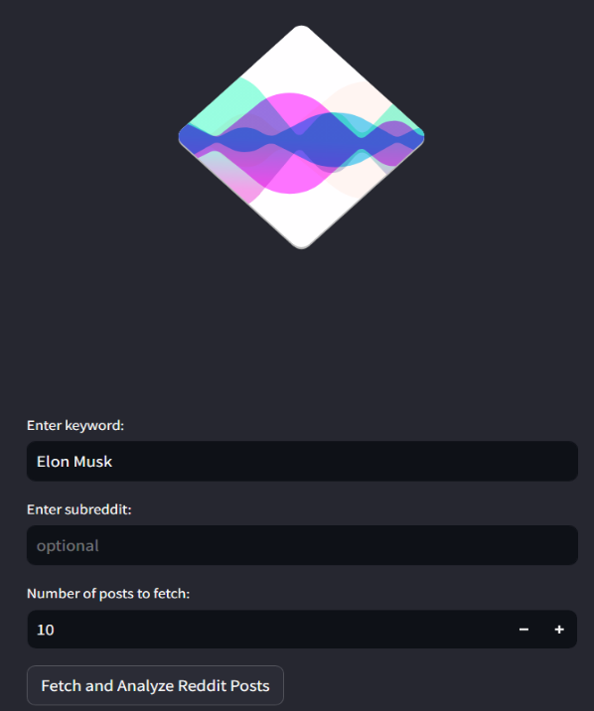
Snapshots
Figure 1 : Home Page

Slide 15
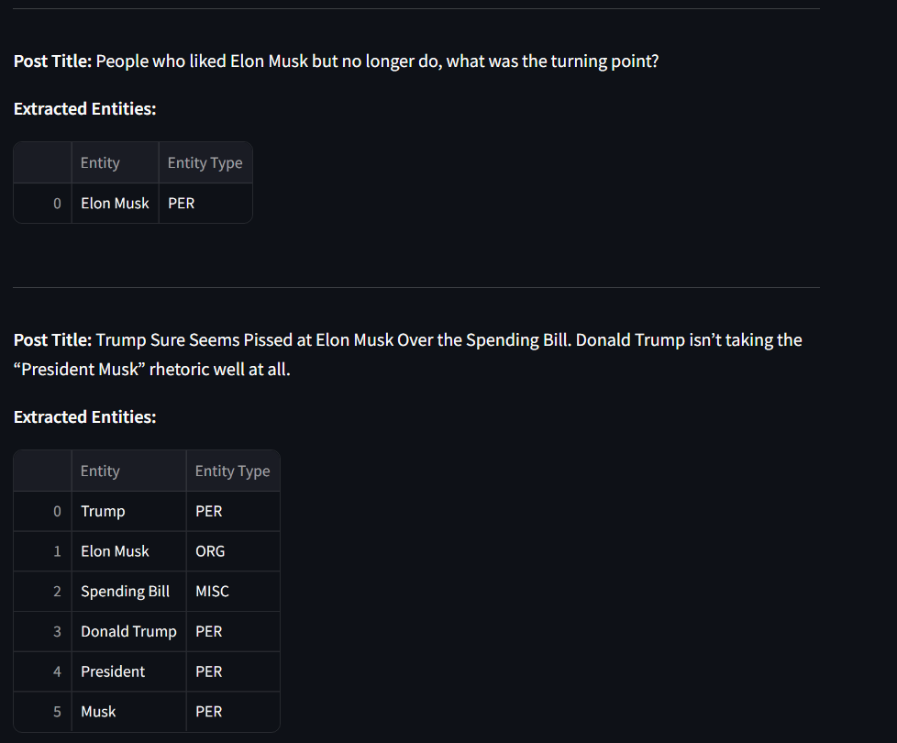
Snapshots
Figure 2 : Result Page

Slide 16
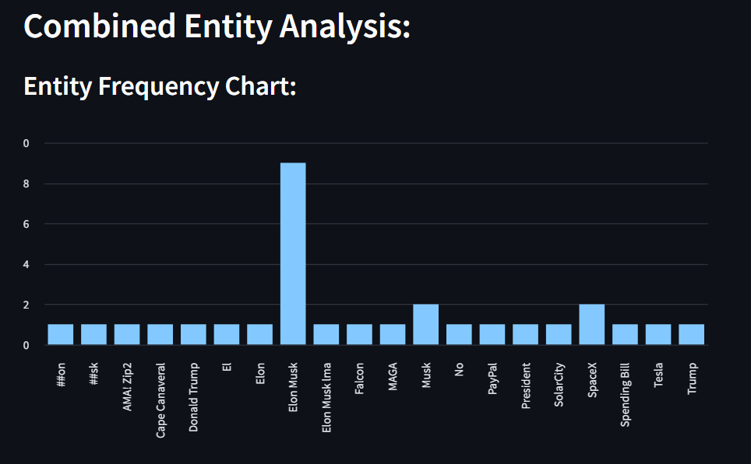
Snapshots
Figure 3 : Combined Entity Analysis

Slide 17
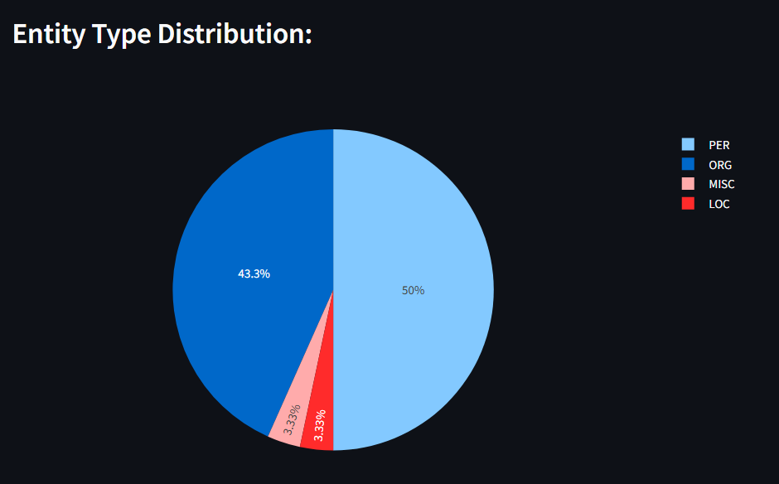
Snapshots
Figure 3 : Combined Entity Type Analysis

Slide 18
Hardware & Software Requirements
Hardware
Processor: i3 or above
Speed: 1.5 GHz
RAM: 8 GB
Hard disk: 40 GB
Software
Operating System: Windows
Technology: Python, Streamlit
IDE: Visual Studio Code

Slide 19
Conclusion
In this project, we have successfully developed a Named Entity Recognition (NER) system utilizing state-of-the-art machine learning techniques. By leveraging transformer-based architectures and contextual embeddings, our model demonstrated significant accuracy and robustness in identifying and classifying entities across various datasets. The results highlight the system's capability to handle complex linguistic phenomena such as ambiguity, context dependency, and entity overlap, which are critical for real-world applications. Despite these achievements, challenges such as domain adaptation, handling unseen entities, and processing low-resource languages remain. These limitations underscore the need for continued innovation in NER systems to ensure adaptability and scalability in diverse environments.

Slide 20
References
[1]. Davlatyor Mengliev, Vladimir Barakhnin, Nilufar Abdurakhmonova, Mukhriddin Eshkulov (2024). Developing Named Entity Recognition Algorithms for Uzbek: Dataset Insights and Implementation. Elsevier
[2]. Saja Murtadha Hashim and Kürşat Mustafa Karaoğlan (2024). Advances in Named Entity Recognition: Exploring State-Of-The-Art Methods. ResearchGate.
[3]. Adyasha Dash, Subhashree Darshana, Devendra Kumar Yadav, Vinti Gupta (2024). A Clinical Named Entity Recognition Model Using Pretrained Word Embedding and Deep Neural Networks. Elsevier
[4]. David Nadeau and Satoshi Sekine. (2024). Multi-granularity Cross-Modal Representation for Emotion Recognition on Social Media. National Research Council Canada / New York University. ScienceDirect
[5]. Hongyu Chen, Li Dan, Yonghe Lu, Minghong Chen, and Jinxia Zhang (2024). An improved data augmentation approach and its application in medical named entity recognition.

